Slide 1
OUTLINES
Introduction – Robotics
Introduction – Automation
Microcontroller
Arduino Uno
Board Types
Shields
Battery selection
Input - Output
Sensors
Software
Arduino Compiler
Arduino Program Development
Arduino C Specific Functions
Practical demos.

Slide 2
ROBOTICS
Robotics is the branch of technology that deals with the design, construction, operation, structural disposition, manufacture and application of robots and computer systems for their control, sensory feedback, and information processing.
Origin of the word robot in 1923 from word
‘robota’ meaning slave labour!

Slide 3
What Is Robot?
A robot is a mechanical or virtual intelligent agent that can perform tasks automatically or with guidance, typically by remote controll.

Slide 4
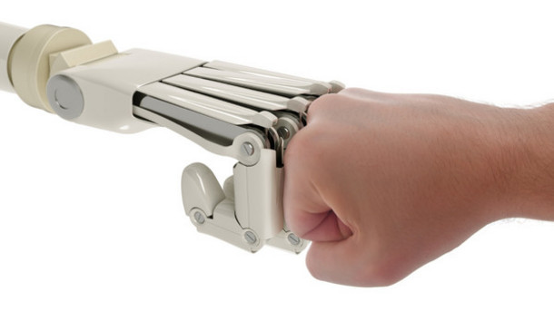
AUTOMATION
Automation or automatic control, is the use of various control systems for operating equipment such as machinery, processes in factories, boilers and heat treating ovens, switching on telephone networks, steering and stabilization of ships, aircraft and other applications and vehicles with minimal or reduced human intervention.

Slide 5
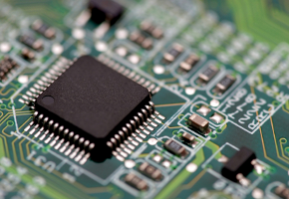
MICROCONTROLLERS – One Definition
Programmers work in the virtual world.
Machinery works in the physical world.
How does one connect the virtual world to the physical world?
Enter the microcontroller.
A microcontroller is basically a small-scale computer with generalized (and programmable) inputs and outputs.
The inputs and outputs can be manipulated by and can manipulate the physical world.

Slide 6
ARDUINO
Physical computing platform
Open source
“Hardware Abstracted”
Wiring Language
USB programmable
Large community
Multi platform Win/Mac/Linux
Inexpensive

Slide 7
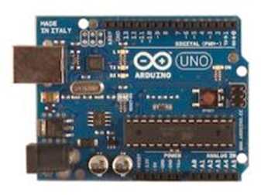
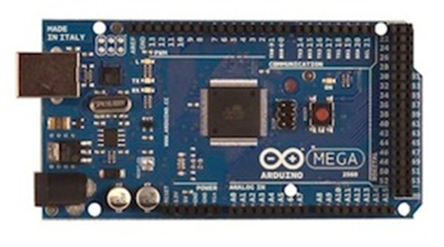
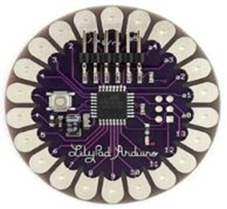
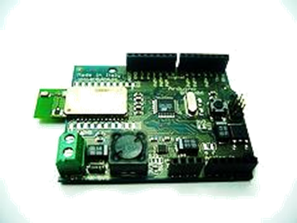
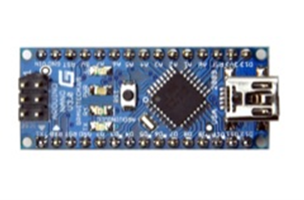
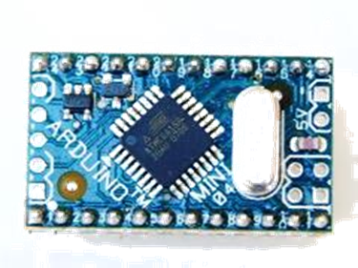
ARDUINO BOARDS
Arduino UNO
Arduino MEGA
LilyPad
Arduino Nano
Arduino Mini
Arduino BT

Slide 8
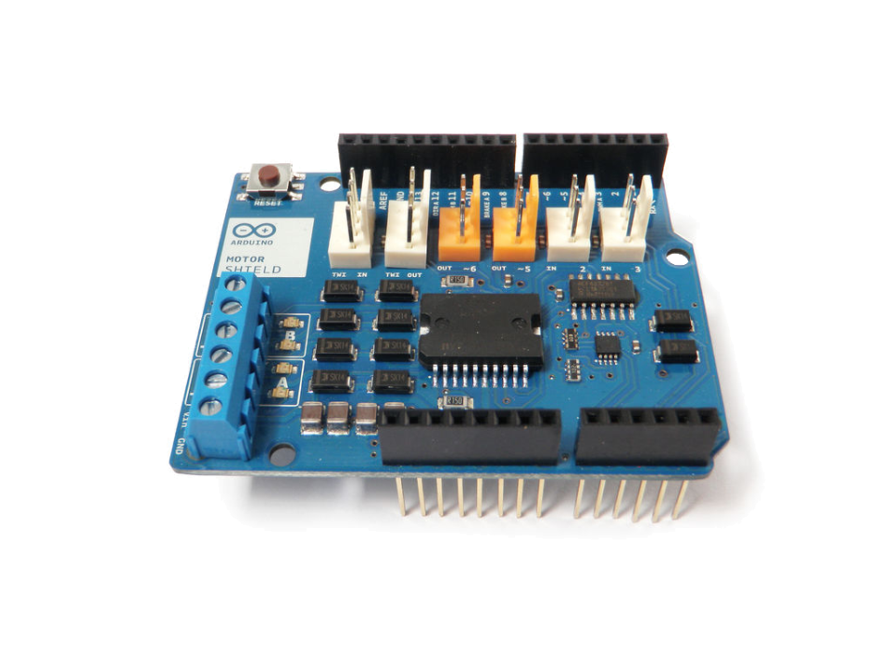
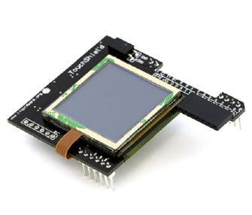
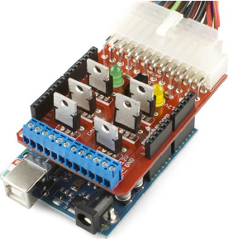
SHIELDS
Shields are circuit boards that plug into the top of an Arduino.
They extend the capabilities of an Arduino.
Examples:
Ethernet
GPS
Motor
Prototype
shieldlist.org

Slide 9
WHERE TO START
Get an Arduino
Download the compiler
Connect the controller
Configure the compiler
Connect the circuit
Write the program
Get frustrated/Debug/Get it to work
Get excited and immediately start next project

Slide 10
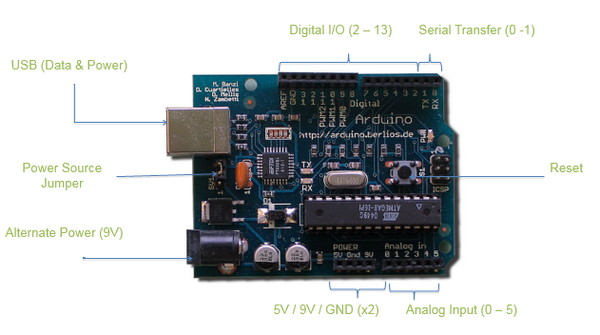

Slide 11
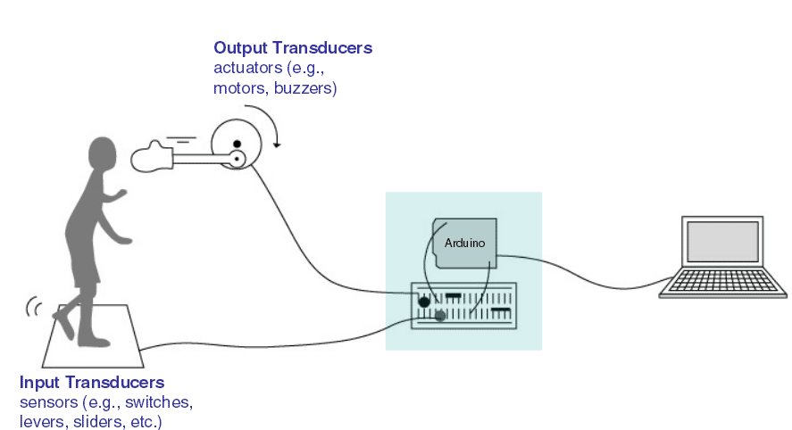
THE INTERACTIVE DEVICE
Most of the objects build using Arduino follow, so called “Interactive Device” pattern.
It is an electronic circuit that is able to sense the environment using components called “sensors” and processing the information through ”behaviour” implemented as software. The device will then be able to interact back with the world using “actuators”.

Slide 12
SENSORS
A device that transforms the physical quantity into electrical value.
Ex.: Light sensor transduce the light into change in voltage or resistance.
Sensors can be both binary or a range.
Usually, sensors that measure a range of values vary their resistance to reflect their detection.
Arduino can only sense voltages, not resistances.
Sensors that only vary their resistances require a circuit called a voltage divider to provide the Arduino a voltage.

Slide 13
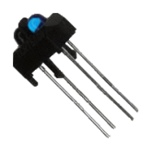
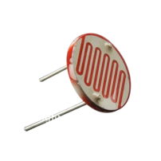
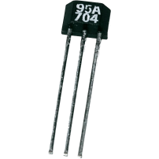
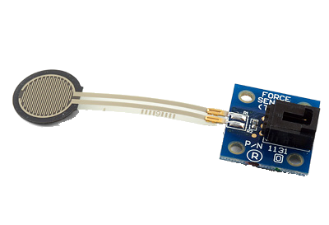
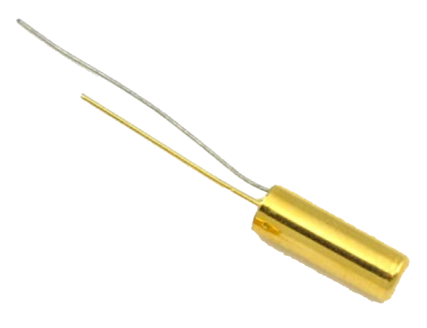
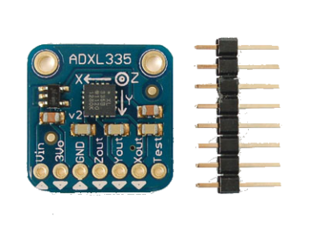
COMMON SENSORS
Dials on a radio are simply potentiometers
Temperature
Light
Angle
Accelerometer (measures motion and tilt)
Infrared sensor & light
Ball tilt sensor (for measuring orientation)
Force
Ultrasonic
Colour

Slide 14
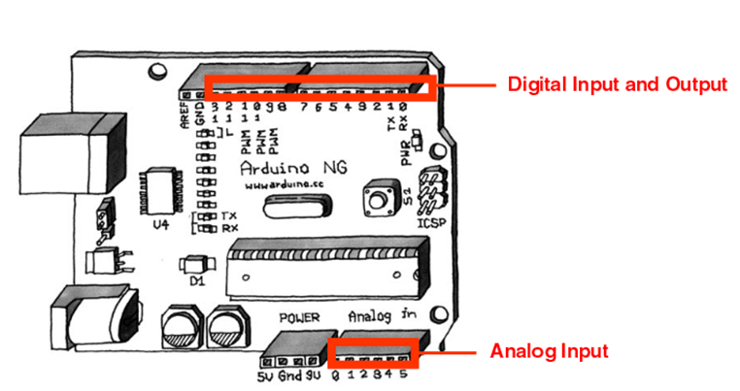
Digital
INPUT
Analog

Slide 15
DIGITAL INPUT
Digital means that the quantity can take specific levels of values with specific offset between each other.
Ex: - English alpha consists of 26 letter, there is no letter between A and B.
- Square waves are Digital.
Digital inputs will come to the Arduino as either on or off (HIGH or LOW, respectively).
HIGH is 5 VDC.
LOW is 0 VDC.

Slide 16
ANALOG INPUT
Analog means that the quantity can take any value between its minimum value and maximum value.
Ex: - Temperature, can take any value[-1,12.8,25.002,… etc.].
- Sine waves are analog.
Analog inputs will come to the Arduino as a range of numbers, based upon the electrical characteristics of the circuit.
0 to 1023, 0.0049 V per digit (4.9 mV)
Read time is 100 microseconds (10,000 a second)
All physical quantities are analog.

Slide 17
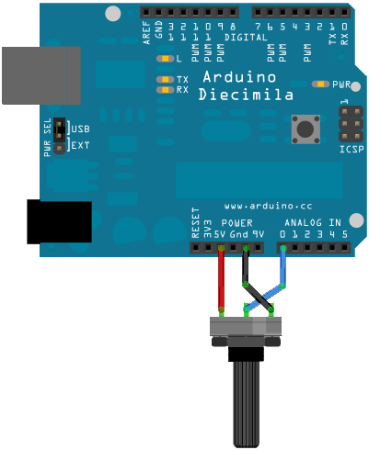
ANALOG INPUT
A potentiometer (variable resistor) is connected to analog pin 0 to an Arduino.
Values presented to pin 0 will vary depending upon the resistance of the potentiometer.
The variable resistor can be replaced with a sensor.
For example, a photo resistor. Depending upon the light level at the photo resistor: Turn on a light, Increase or decrease the brightness of an LED (or an LED array)
Most sensors are simply variable resistors, but vary their resistance based on some physical characteristic.

Slide 18
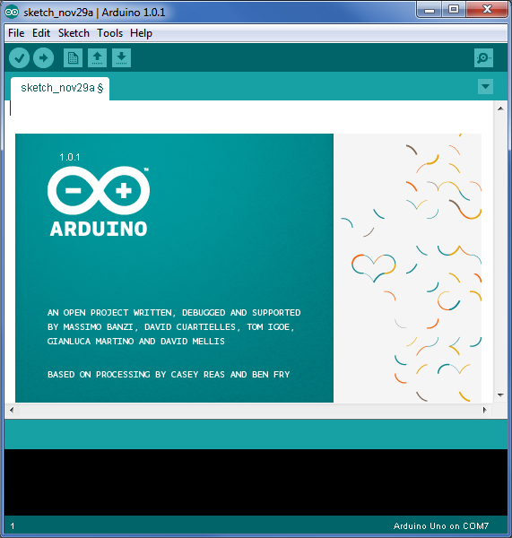
ARDUINO COMPILER
Download current compiler from:
arduino.cc/en/Main/software
Arrogantly refers to itself as an IDE (Ha!).
Run the software installer.
Written in Java, it is fairly slow.

Slide 19
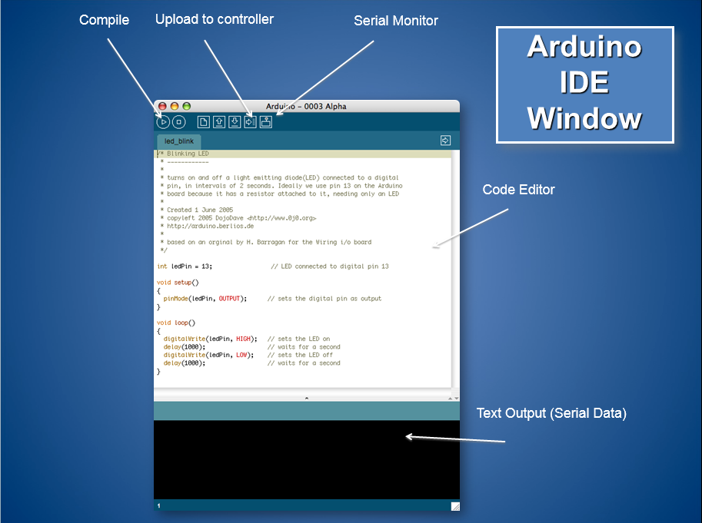

Slide 20
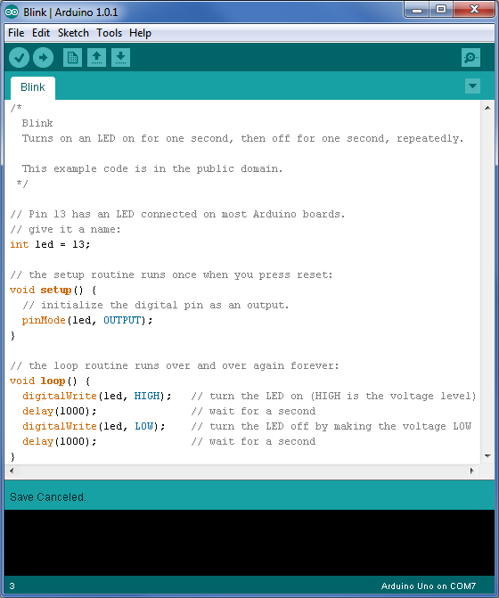
COMPILER FEATURES
Numerous sample sketches are included in the compiler.
Located under File, Examples.
Once a sketch is written, it is uploaded by clicking on File, Upload, or by pressing <Ctrl> U

Slide 21
SOFTWARE
Cross platform - runs on Windows, Mac OS X and Linux; written in Java and based on Processing programming language, avr-gcc, and other open source software.
Arduino – IDE designed to introduce programming to artists and other users unfamiliar with software
development.
Includes a code editor with brace matching, automatic indentation, API lookup, capable of compiling
and uploading programs to the board with one click.
Processing - Processing is an open source programming language and environment for people who want to program images, animation, and interactions.
It is used by students, artists, designers, researchers, and hobbyists for learning, prototyping, and production.
It is created to teach fundamentals of computer programming within a visual context and to serve as a software sketchbook and professional production tool.

Slide 22
ARDUINO PROGRAM DEVELOPMENT
Based on C++ without 80% of the instructions.
A handful of new commands.
Programs are called 'sketches'.
Sketches need two functions:
void setup( )
void loop( )
setup( ) runs first and once.
loop( ) runs over and over, until power is lost or a new sketch is loaded.

Slide 23
ARDUINO C SPECIFIC FUNCTIONS
pinMode(pin, mode)
Designates the specified pin for input or output
digitalWrite(pin, value)
Sends a voltage level to the designated pin
digitalRead(pin)
Reads the current voltage level from the designated pin
analog versions of above
analogRead's range is 0 to 1023
serial commands
print, println, write

Slide 24
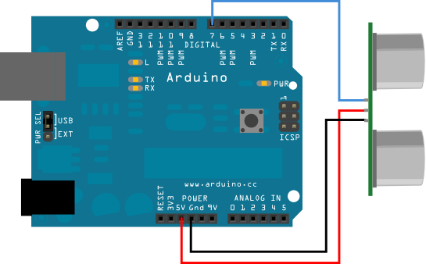
ARDUINO CODE BASICS
Commands and other information are sent to LED’s, motors and from sensors through digital and analog input & output pins.

Slide 25
Arduino programs run on two basic sections:
void setup() {
//setup motors, sensors etc
}
void loop() {
// get information from sensors
// send commands to motors
}

Slide 26
SETUP
The setup section is used for assigning input and outputs (Examples: motors, LED’s, sensors etc) to ports on the Arduino.
It also specifies whether the device is OUTPUT or INPUT.
To do this we use the command “pinMode”.
void setup() {
pinMode(9,OUTPUT);
}
port #
Input or Output

Slide 27
LOOP
Port # from setup
void loop() {
digitalWrite(9, HIGH);
delay(1000);
digitalWrite(9, LOW);
delay(1000);
}

Slide 28
INPUT & OUTPUT
Transferring data from the computer to an Arduino is done using Serial Transmission.
To setup Serial communication we use the following
void setup() {
Serial.begin(9600);
}

Slide 29
VARIABLES
A variable is like “bucket”.
It holds numbers or other values temporarily.
DECLARING A VARIABLE
int
assignment
“becomes”
Type
value
variable name

Slide 30
USING VARIABLES
int delayTime = 2000;
int greenLED = 9;
void setup() {
pinMode(greenLED, OUTPUT);
}
void loop() {
digitalWrite(greenLED, HIGH);
delay(delayTime);
digitalWrite(greenLED, LOW);
delay(delayTime);
}
Declare delayTime
Variable
Use delayTime
Variable

Slide 31
int delayTime = 2000;
int greenLED = 9;
void setup() {
pinMode(greenLED, OUTPUT);
}
void loop() {
digitalWrite(greenLED, HIGH);
delay(delayTime);
digitalWrite(greenLED, LOW);
delayTime = delayTime - 100;
delay(delayTime);
}
subtract 100 from
delayTime to gradually
increase LED’s blinking
speed

Slide 32
VALUE COMPARISONS
GREATER THAN
a > b
GREATER THAN OR EQUAL
a >= b
LESS
a < b
LESS THAN OR EQUAL
a <= b
EQUAL
a == b
NOT EQUAL
a != b

Slide 33
CONDITIONS
To make decisions in Arduino code we use an ‘if’ statement.
‘If’ statements are based on a TRUE or FALSE question

Slide 34
IF CONDITION
if(true)
{
“perform some action”
}

Slide 35
IF EXAMPLE
int counter = 0;
void setup() {
Serial.begin(9600);
}
void loop() {
if(counter < 10)
{
Serial.println(counter);
}
counter = counter + 1;
}

Slide 36
IF - ELSE CONDITION
if( “answer is true”)
{
“perform some action”
}
else
{
“perform some other action”
}

Slide 37
IF - ELSE EXAMPLE
int counter = 0;
void setup() {
Serial.begin(9600);
}
void loop() {
if(counter < 10)
{
Serial.println(“less than 10”);
}
else if (counter == 10)
{
Serial.println(“equal to 10”);
}
else
{
Serial.println(“greater than 10”);
Serial.end();
}
counter = counter + 1;
}

Slide 38
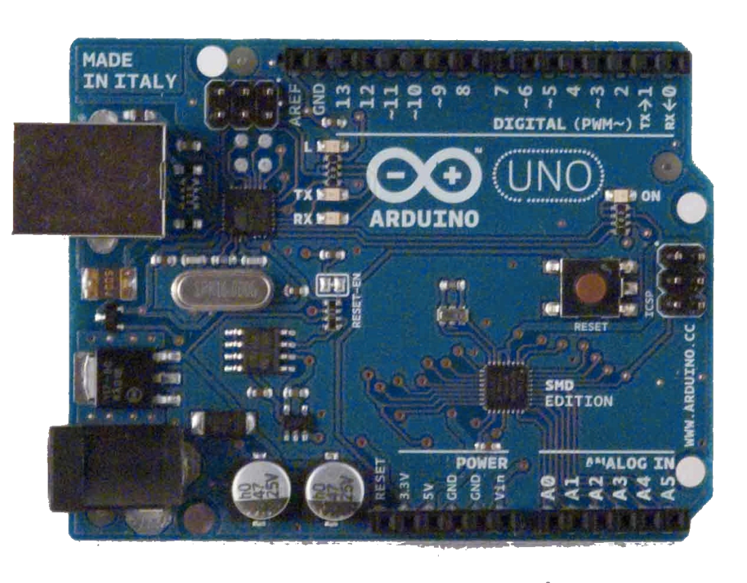
Blink Sketch
void setup( ) {
pinMode(13, OUTPUT);
}
void loop( ) {
digitalWrite(13, HIGH);
delay(1000);
digitalWrite(13, LOW);
delay(1000);
}
Connected to other end of the circuit
Connected to one end of the circuit

Slide 39
4 LED Blink Sketch
void setup( ) {
pinMode(1, OUTPUT);
pinMode(3, OUTPUT);
pinMode(5, OUTPUT);
pinMode(7, OUTPUT);
}
void loop( ) {
digitalWrite(1, HIGH);
delay (200);
digitalWrite(1, LOW);
digitalWrite(3, HIGH);
delay (200);
digitalWrite(3, LOW);
digitalWrite(5, HIGH);
delay (200);
digitalWrite(5, LOW);
digitalWrite(7, HIGH);
delay (200);
digitalWrite(7, LOW);
}

Slide 40
CONCLUSION
The Arduino microcontroller is a low cost way to enter into the hobby of robotics.
The Arduino has two plusses over any other:
The user community
Extensive online library of code and projects.
Viewed as the "base" system, upon which all other microcontrollers are built.
Compatibility.
So get a kit, and start ushering in the inevitable takeover of our robotic overlords!

Slide 41





Thanks for coming
www.bitsbilaspur.com

